Slide 1
FINAL PROJECT
Srilaya Valmeekam

Slide 2

Objective
To analyze the monthly fuel contract information, purchases, and costs related to the US energy data.

Slide 3
INTRODUCTION:
The information on monthly fuel contracts, purchases, and costs is found in EIA-923 Schedule 2, Part A, which is the source of the data that we used.
A sample of 2% of the total data (which had 608,565 rows) was taken using a seed of 2467 to improve the interpretation of the data.
The fuel type code pudl variable has been turned into a numerical variable by creating three dummy variables for three different types of fuel.

Slide 4
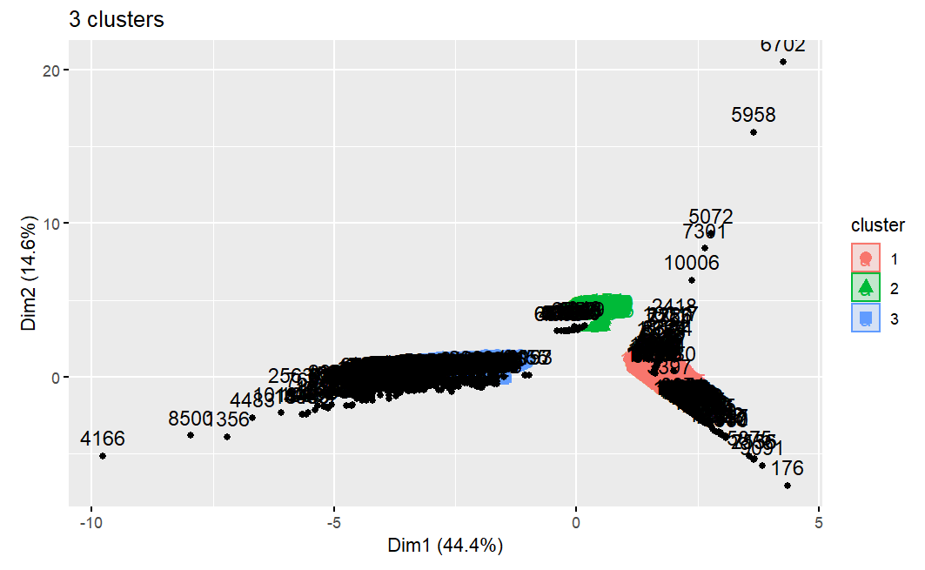
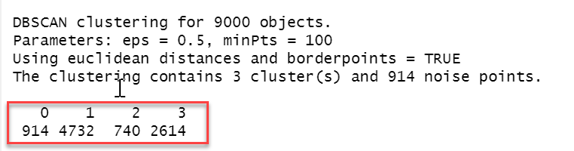
The algorithm used to form Clusters:
DBSCAN algorithm is used to form clusters in order to draw meaningful insights about U.S. energy.
DBSCAN is known to be the best algorithm that handles outliers and noisy data.
Why DBSCAN?

Slide 5
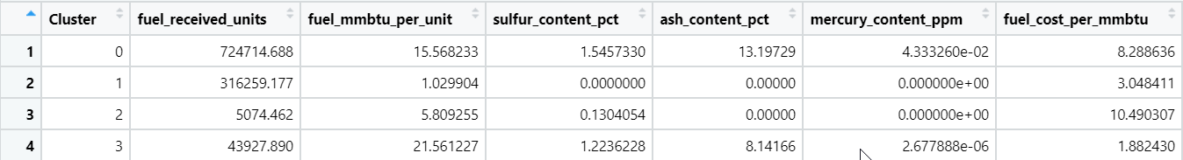
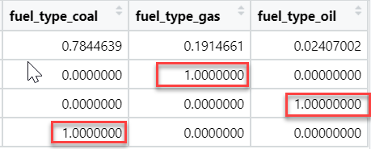
Findings from Clusters:
Names of each cluster:
Cluster 1: Gas
Cluster 2: Oil
Cluster 3: Coal

Slide 6
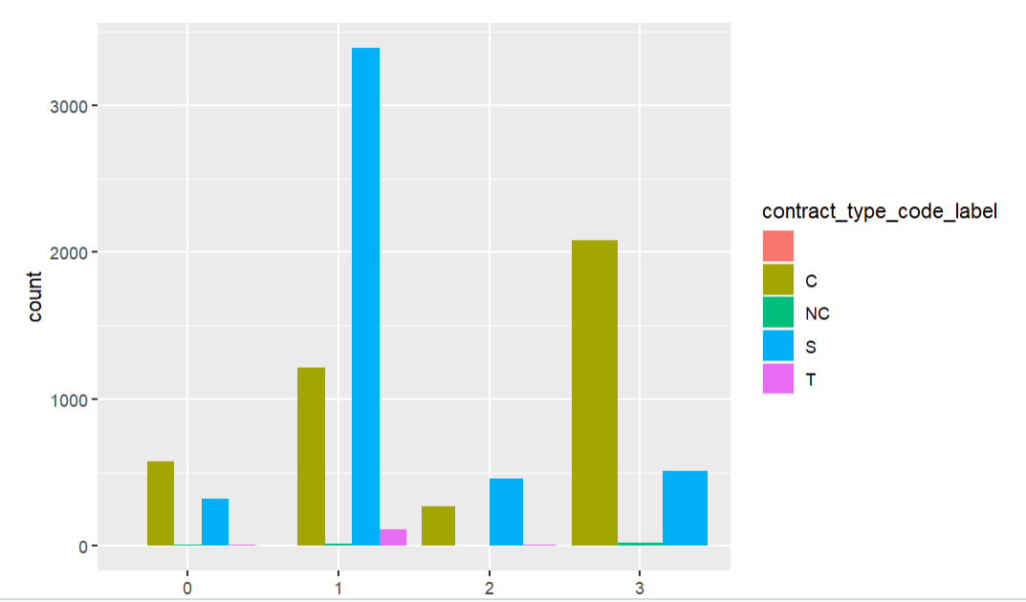
Analysis of Clusters 1: Gas
Fuel Received Units | Fuel mmbtu per Unit | Sulfur Content pct | Ash Content pct | Mercury Content ppm | Fuel cost per mmbtu
316259.17 | 1.0299 | 0.00 | 0.00 | 0.00 | 3.0484
Low Fuel cost per MMBtu
The highest Number of units received
No chemical components
Heat generated is less
Contract type is Contract based.

Slide 7
Analysis of Clusters 2: Oil
Fuel Received Units | Fuel MMBtu per Unit | Sulfur Content pct | Ash Content pct | Mercury Content ppm | Fuel cost per mmbtu
5074.462 | 5.8093 | 0.1340 | 0.00 | 0.00 | 10.4903
Highest Fuel cost per MMBtu
Least number of units received
Small percent of Sulfur Content
The heat generated is 5.8 MMBtu
Contract type is Spot

Slide 8
Analysis of Clusters 3: Coal
Fuel Received Units | Fuel MMBtu per Unit | Sulfur Content pct | Ash Content pct | Mercury Content ppm | Fuel cost per mmbtu
43927.890 | 21.5612 | 1.2236 | 8.1416 | 2.678e-06 | 1.8824
Lowest Fuel cost per MMBtu
High fuel units received
Contains Fuel, ash, sulfur content
Heat generated is High
Contract type is Contract and Spot

Slide 9
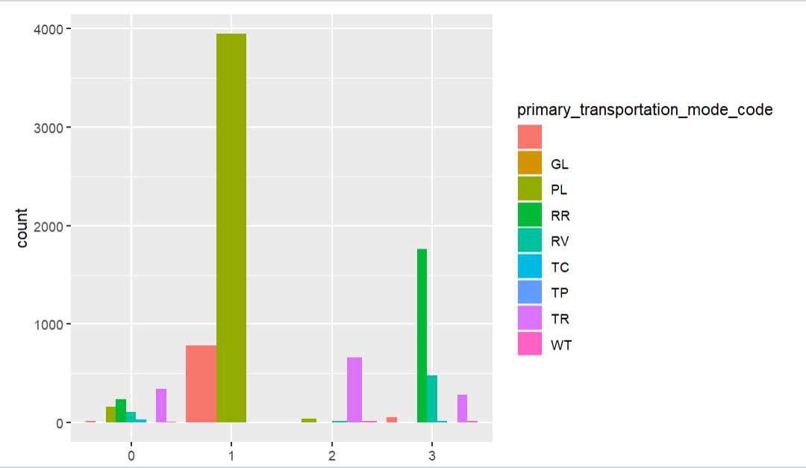
Comparing 3 types of fuels:

Slide 10

Conclusion:
The type of fuel to be excluded from power generation is Coal as there is an immediate need to cut down the usage of Coal and preserve it for future generations.
The amount spent on Coal is way too higher than on Gas and Oil.
Based on the findings, I propose that the government does not focus on removing the fuel that receives the least funding.
As a result, rather than wasting lots of money on coal, the government can redirect the money to oil, which is available in its purest form and can be used for a variety of purposes.

Slide 11
Thank you

